Slide 1
The Forum Bar

Slide 2
Background to the bar
Mustafa (Abu Hamza) v Government of the United States of America [2007] QB 659
R (Bermingham) v Director of the Serious Fraud Office [2007] QB 727
Ahsan v Government of the United States of America [2008] EWHC 66
R (McKinnon) v Director of Public Prosecutions [2009] EWHC 2021.
R (Bary) v Secretary of State for the Home Department [2009] EWHC 2068 (Admin).
Norris v Government of the United States (No. 2) [2010] 2 AC 487

Slide 3
Police and Justice Act 2006, sch. 13, para. 5 - never brought into force
The Scott Baker Review: A Review of the United Kingdom’s Extradition Arrangements, 30 September 2011, Part 6
Home Affairs Select Committee - The US-UK Extradition Treaty (HC 644)
The Government Response to Sir Scott Baker's Review of the United Kingdom's Extradition Arrangements (Cm 8458)

Slide 4
Introduction of the forum bar
The Crime and Courts Act 2013, section 50 and Schedule 20, paras 1-9
Commencement:
  England, Wales and Northern Ireland – Crime and Courts Act 2013 (Commencement No 5) Order 2013/2349
  Scotland – Crime and Courts Act 2013 (Commencement No 19) Order 2021/1018
Scottish litigation - Craig v Advocate General for Scotland [2018] CSOH 117; [2020] HCJAC 22; [2022] 1 WLR 1270

Slide 5
Overview of the forum provisions
ss. 19B/83B – the forum bar
ss. 19C/83C - The judge hearing proceedings under section 19B/83B must decide that the extradition is not barred by reason of forum if (at a time when the judge has not yet decided the proceedings) the judge receives a prosecutor's certificate relating to the extradition
ss. 19D/83D – requirements for a Prosecutor’s Certificate
s. 19E - Challenges to the issue of a Prosecutor’s Certificate
ss. 19F/83E – Interpretation

Slide 6
Section 19B/83B of the Extradition Act 2003
(1) The extradition of a person (“D”) to a [category 1/category 2] territory is barred by reason of forum if the extradition would not be in the interests of justice.
(2) For the purposes of this section, the extradition would not be in the interests of justice if the judge—
(a) decides that a substantial measure of D's relevant activity was performed in the United Kingdom; and
(b) decides, having regard to the specified matters relating to the interests of justice (and only those matters), that the extradition should not take place.

Slide 7
The interest of justice factors
(a) the place where most of the loss or harm resulting from the extradition offence occurred or was intended to occur;
(b) the interests of any victims of the extradition offence;
(c) any belief of a prosecutor that the United Kingdom, or a particular part of the United Kingdom, is not the most appropriate jurisdiction in which to prosecute D in respect of the conduct constituting the extradition offence;

Slide 8
(d) were D to be prosecuted in a part of the United Kingdom for an offence that corresponds to the extradition offence, whether evidence necessary to prove the offence is or could be made available in the United Kingdom;
(e) any delay that might result from proceeding in one jurisdiction rather than another;
(f) the desirability and practicability of all prosecutions relating to the extradition offence taking place in one jurisdiction, having regard (in particular) to—
(i) the jurisdictions in which witnesses, co—defendants and other suspects are located, and
(ii) the practicability of the evidence of such persons being given in the United Kingdom or in jurisdictions outside the United Kingdom
(g) D's connections with the United Kingdom.

Slide 9
Approach to the interest of justice factors
The purpose of the bar is to prevent extradition where the offences can be fairly and effectively tried in the UK, and it is not in the interests of justice that the requested person should be extradited - Love v USA [2018] EWHC 172 (Admin), para 22:
Ultimate test if whether extradition would not be in the interests of justice - Dibden v Tribunal De Grande Instance De Lille, France [2014] EWHC 3074 (Admin), para 18; Shaw v USA [2014] EWHC 4654 (Admin), para 41
But it is not a general interests of justice test but rather is calibrated to the issues listed in 19B(3)/83B(3) - Patman & Safi v Specialist Criminal Court In Pezinok, Slovakia [2020] EWHC 3512, para 18
The Court must have regard to each of the factors, but there is no hierarchy to them and the weight (if any) to be afforded to each one will always require a fact-specific analysis; what is required is an overall judgment as to whether the particular extradition would not be in the interests of justice: Shaw, para. 40; Dibden, para. 18

Slide 10
The place where most of the loss or harm resulting from the extradition offence occurred or was intended to occur
Usually a very weighty factor – Love, para 28
But not definitive, even where all the harm occurred in the requesting state – Love, para 17; McDaid v USA [2020] EWHC 1527 (Admin), para 24, Scott v USA [2018] EWHC 2021 (Admin) at paras. 38-39.

Slide 11
The interests of any victims of the extradition offence
The views of victims are relevant but not determinative. If the choice is between a trial in one jurisdiction and no trial in another jurisdiction then the interests of the victims is likely to favour a trial in the jurisdiction where the trial will take place – Shaw, para 61; Scott, para 43
Convenience of witnesses is a relevant factor, Scott, para 42
The extent to which other defendants have already been prosecuted in the requesting state, and the payment of compensation to the victim (including civil settlements) may also be relevant considerations – Scott, para 44

Slide 12
Any belief of a prosecutor that the United Kingdom, or a particular part of the United Kingdom, is not the most appropriate jurisdiction in which to prosecute D
The prosecutor referred to is a domestic prosecutor; there are no formal requirements for the way that the ‘belief’ is expressed: Scott, para 26; Shaw, para. 52
A “belief” enjoys no special significance amongst the specified factors: USA v Osborne [2022] EWHC 35 (Admin), para 70; the weight to be attached to it is a matter for the judge Wyatt v USA [2019] EWHC 2978 (Admin), para 18
Greater weight will be placed on a belief that the Court considers to be sound than if it appears to be flimsy, ill-considered or irrational (in which case it would carry little or no weight at all) – Scott, para 35

Slide 13
Whether evidence necessary to prove the offence is or could be made available in the United Kingdom
This factor is concerned with the "evidence necessary to prove the offence” which is not the same as all the evidence which might be available in a prosecution in the requesting State - Scott, para 49
What is required is a comparison between the availability of evidence in this country and that in the requesting state – Shaw, paras. 49-50
The relevance of any evidence to the trial issues, the necessity or otherwise of calling witnesses live and whether the evidence is transferrable are relevant considerations – Scott, para 49; McDaid, para 27.
The touchstone is what is practical and what is effective: Patman & Safi, para 27

Slide 14
Any delay that might result from proceeding in one jurisdiction rather than another
Fact-specific. Cases where the factor has been of weight in the overall interests of justice consideration have been:
those where there is evidence that either a trial in the requesting state could take years (where the factor tended against extradition, eg McDaid, paras 28, 35, 48); or
whether the evidence was that trial in the requesting state would be expeditious (where the factor tended in favour of extradition, eg Wyatt, paras 11, 14)

Slide 15
The desirability and practicability of all prosecutions relating to the extradition offence taking place in one jurisdiction
This consideration is particularly directed to the location of witnesses and practicability of such persons giving evidence in the UK
The weight to be applied to this factor may depend on the extent to which separate trials of co-defendants is inevitable - Scott, para. 55; McDaid, para. 29
Practicability can include questions of cost – Piotrowicz v Regional Court in Gdansk, [2014] 3884 (Admin), para 30
The advantages of trying all defendants in the same jurisdiction extend to the benefits of trying the defendants under the same law, before the same courts and ensuring those convicted are sentenced under the same sentencing regime Ejinyere v USA [2018] EWHC 2841 (Admin), para 38

Slide 16
D's connections with the United Kingdom
Connections are not confined to those arising from citizenship or residence but is closer than the notion of ‘ties’ for the purpose of bail decisions. Includes:
family ties,
employment and studies,
property,
the duration and status of residence and nationality;
health conditions if there is a specific factor connected to treatment in the UK;
Love, paras 40-41
Other factors can include the extent to which a person has cooperated in an investigation in the UK – Osborne, paras 89-90

Slide 17
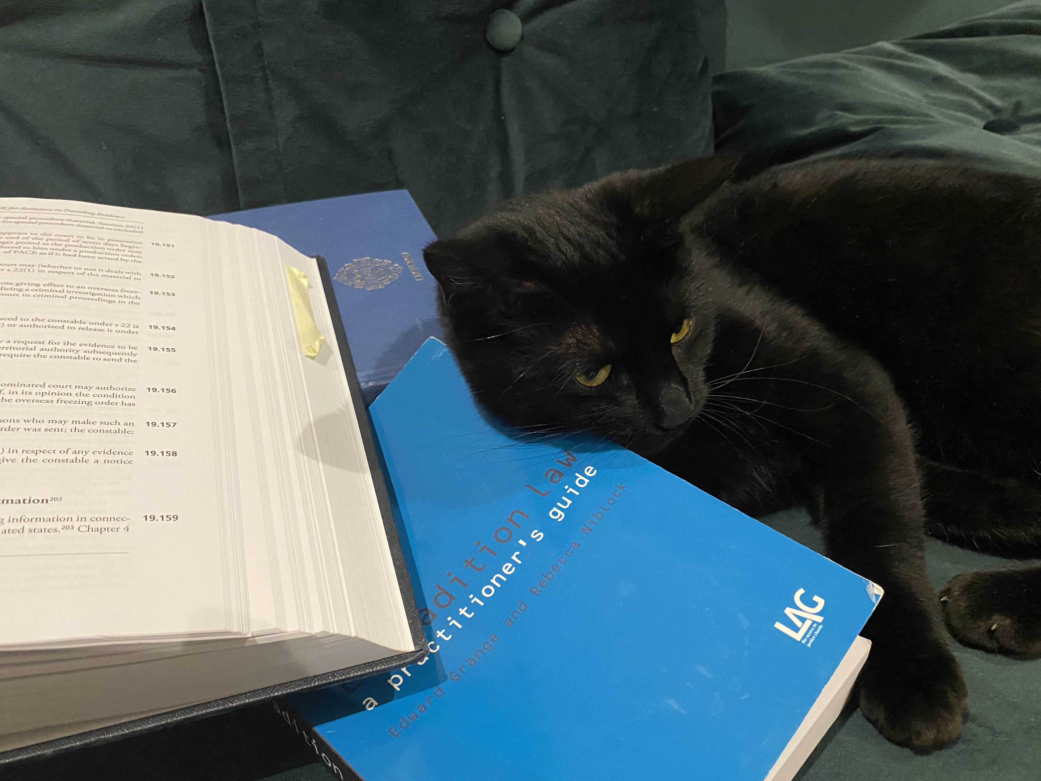
Themes from the case-law

